Slide 1
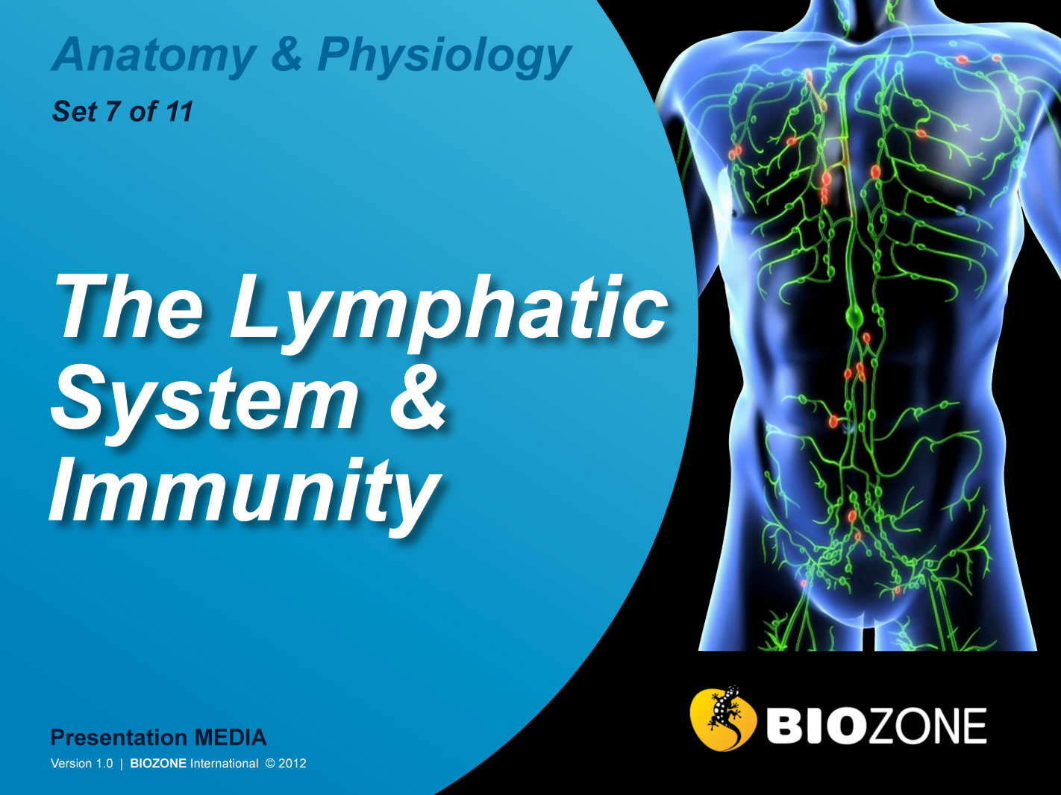

Slide 2
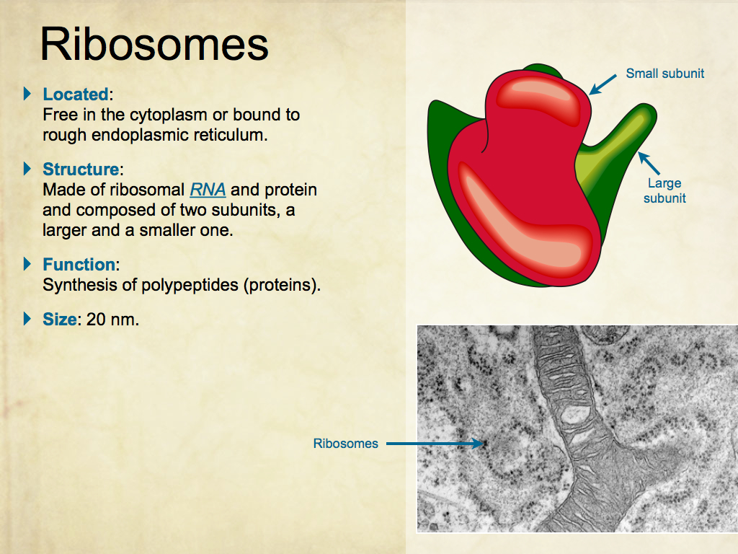
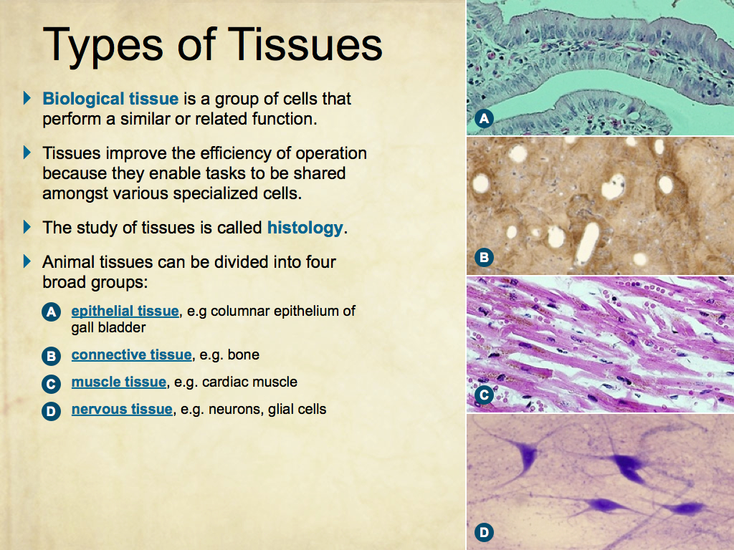
Using Presentation Media
BIOZONE Presentation Media
can be used either as a simple slide show or as an interactive lesson.
  Hyperlinks within the text take you to related slides.
Italicized hyperlinks link to the glossary of definitions.
Bold hyperlinks give direct access to specific slides.

Slide 3
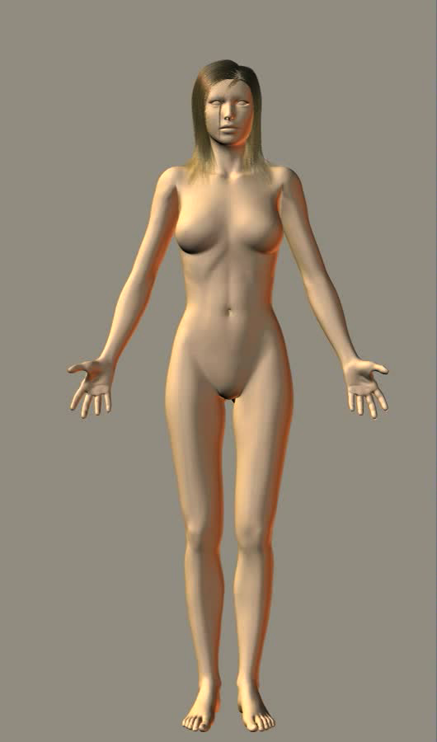
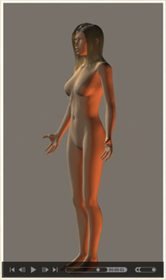
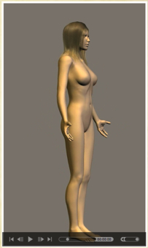
Using Presentation Media
BIOZONE Presentation Media can be used either as a simple slide show or as an interactive lesson
  The movie player allows you to rotate objects.
The movie loops continuously when activated
Use the movie controls in Keynote or Powerpoint
Pause the movie, then drag the slider to rotate the object back and forth

Slide 4
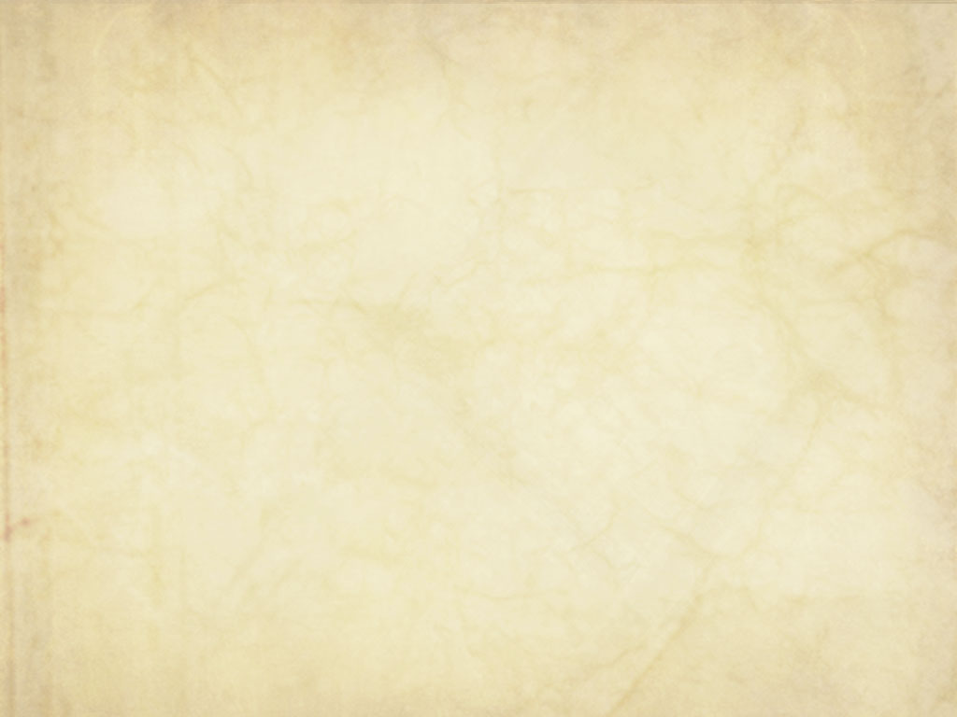
Introduction
  Interacting Systems
  Contexts
The Body and Defense
  Targets for defense
  The body’s natural microbiota
  Distinguishing self
  Blood antigens
  The body’s defenses
Lymph and Immunity
  Lymphatic system
  Immunity
  The immune system
  Antibodies and antigens
  HIV
Medical technology
  Monoclonal antibodies
  Organ transplants
  Stem cell technology
  Gene therapy
Immune system disorders
  Hayfever
  Asthma
Glossary

Slide 5
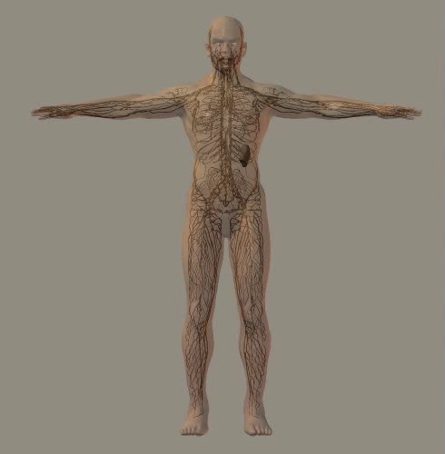
Lymphatic System
The lymphatic system (or lymphoid system) consists of a network of lymphatic vessels and lymphoid tissues and organs.
Fluid leaks from capillaries to bathe the tissues. The lymphatic vessels return this tissue fluid as lymph back into general circulation.
  The lymphoid tissues contain phagocytes and lymphocytes, which are an essential part of the immune system.
  The lymphoid tissues filter cellular debris and help to destroy pathogens so that the lymph can be safely returned to the circulatory system.

Slide 6
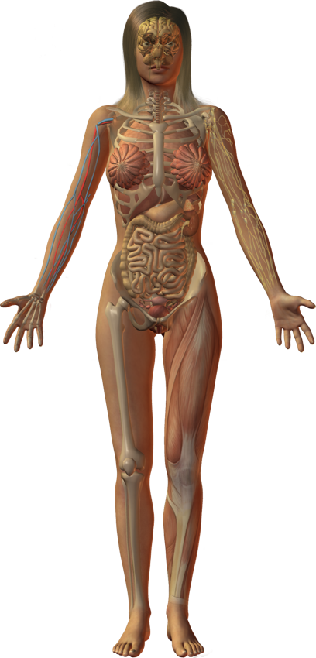
Interacting Systems
Nervous system
Endocrine system
Cardiovascular system
Respiratory system
The lymphatic system is a major part of the body’s immune system.
The tissues and organs within the lymphatic system include bone marrow, thymus, spleen, and tonsils.
The functions of lymphatic system include:
  Removing interstitial fluid from tissues.
  Absorbing and transporting fatty acids and triglycerides.
  Transporting cells involved in the immune response.
The interactions of the lymphatic system with other systems are described in the following slides.
Digestive system
Urinary system
Reproductive system
Integumentary system
Skeletal system
Muscular system

Slide 7
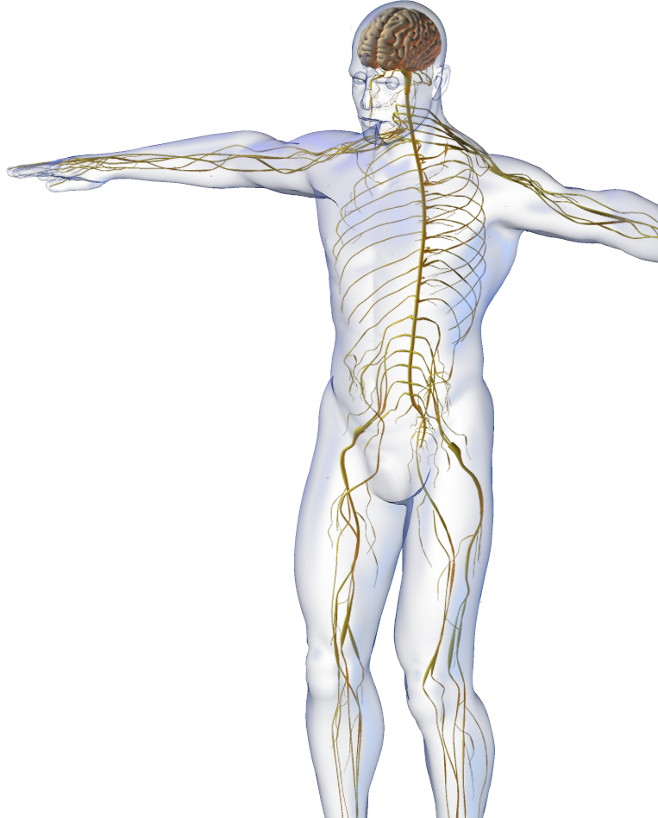

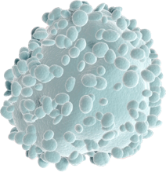
Nervous System
The lymphatic system interacts with the nervous system.
  The lymphatic vessels pick up leaked plasma and proteins from the peripheral nervous system.
  The nervous system innervates larger lymphatic vessels.
  The central nervous system
  coordinates immune responses.
iStock
Lymphocyte

Slide 8
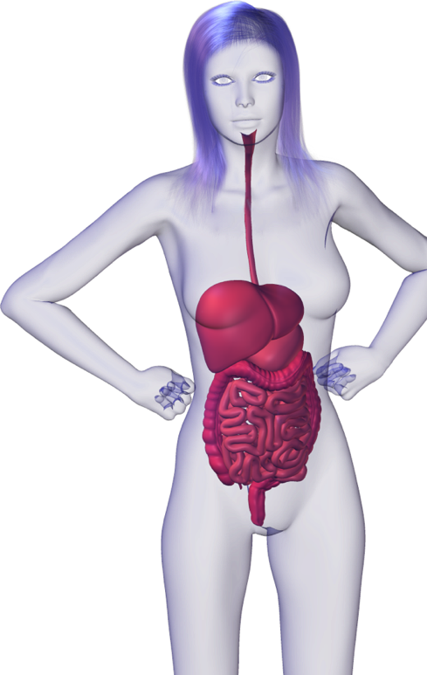
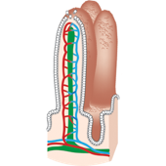
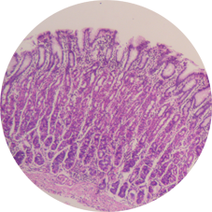
Digestive System
The lymphatic system interacts with the digestive system.
  The lymphatic vessels of the small intestine (the lacteals) drain fat-laden lymph from the gut to the liver.
  Lymphoid nodules in the intestinal wall help prevent invasion by pathogens.
  Stomach acid destroys pathogens, aiding the body’s defenses.
Villi
EII
Stomach epithelium

Slide 9
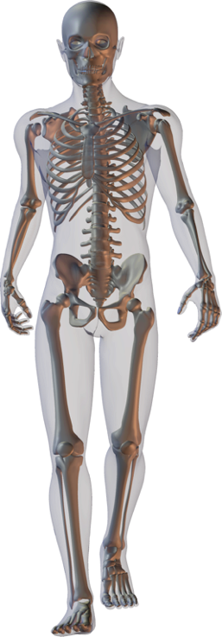
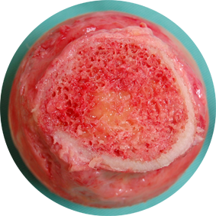
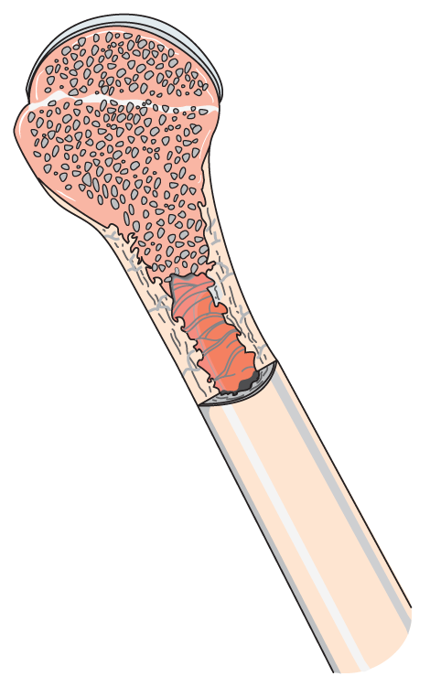
Skeletal System
The lymphatic system interacts with the skeletal system.
  Stem cells in the bone marrow give rise to the immune system’s cells: lymphocytes, granulocytes, and macrophages.
  B lymphocytes (B cells) also mature in the red bone marrow.
  Bones protect the lymphatic organs.
Steven Fruitsmaak
iStock
Lymphocyte

Slide 10
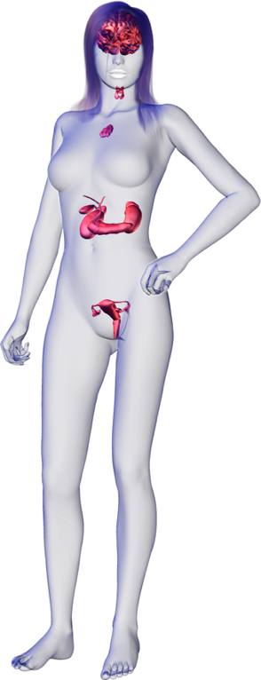
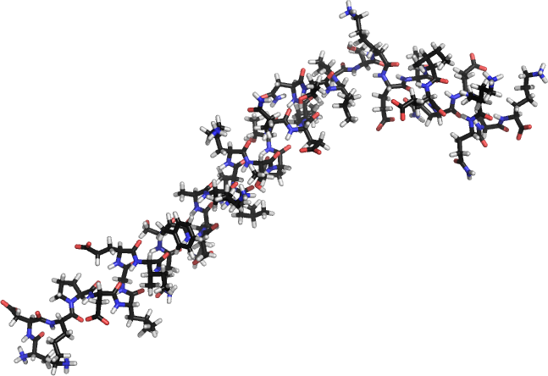
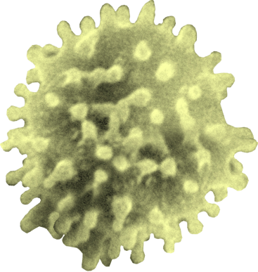
Endocrine System
The lymphatic system interacts with the endocrine system.
  Lymph helps to distribute hormones.
  Hormones produced by the thymus (but also other tissues) are critical to development, maturation, and activity of T-lymphocytes.
  T-lymphocytes develop in the thymus.
Thymosin hormone
Lymphocyte

Slide 11
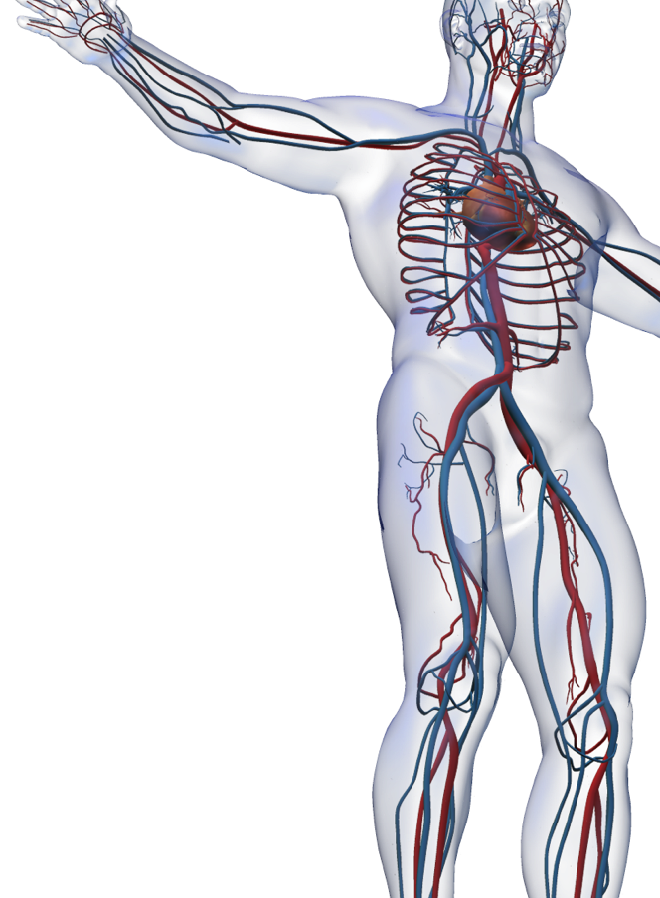
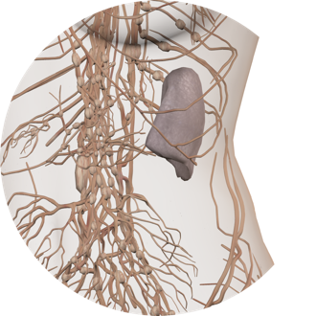

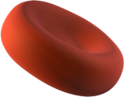
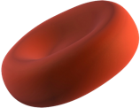

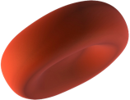
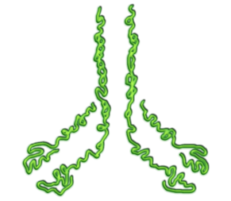
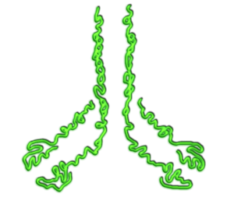
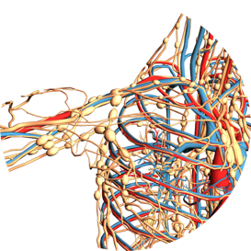
Cardiovascular System
The lymphatic system interacts with the cardiovascular system.
  The spleen stores iron and removes aged red blood cells and debris from the blood.
  Immune elements (cells and chemicals) circulate in the blood.
  Blood is a source of lymph.
iStock
Antibodies

Slide 12
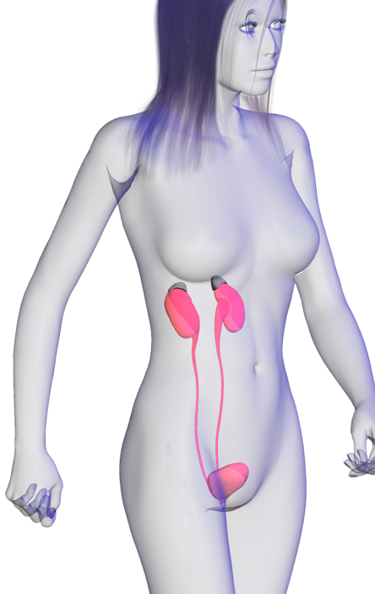
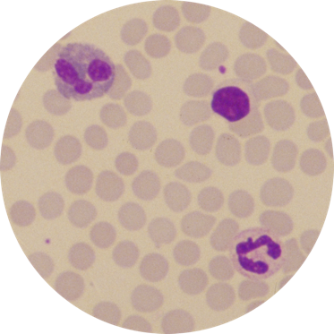
Urinary System
The lymphatic system interacts with the urinary system
  Urinary system removes wastes and helps regulate the pH and electrolytes of the blood, maintaining correct conditions for the cells and tissues of the body’s immune system.
EII
Lymphocytes in blood

Slide 13
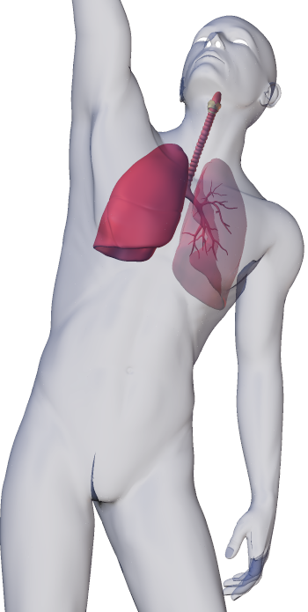
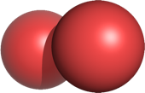
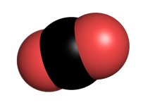
Respiratory System
The lymphatic system interacts with the respiratory system.
  Respiratory system provides O2 required by the cells and tissues of the lymphatic system, and disposes of CO2 produced by cellular respiration.
O2
CO2

Slide 14
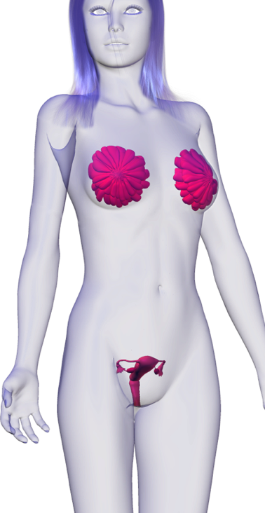
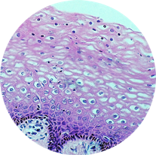
Reproductive System
The lymphatic system interacts with the reproductive system.
  Lymphatic system removes leaked fluid from the cells of the reproductive organs.
  Vaginal secretions inhibit bacterial growth, aiding the immune system in defense.
EII
Vaginal epithelium

Slide 15
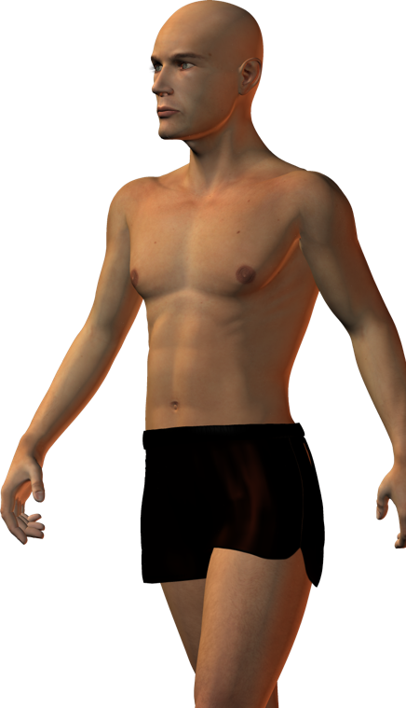
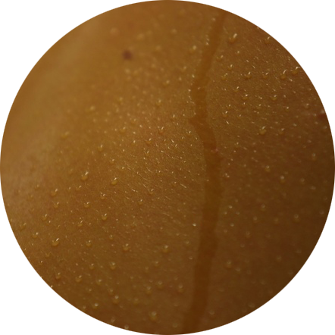
Integumentary System
The lymphatic system interacts with the integumentary system.
  Lymphatic systems picks up leaked plasma fluid from the dermis.
  The skin’s defensive role is enhanced by lymphocytes.
  Skin secretions inhibit bacterial growth, aiding the immune system in the body’s defense.
Lymphocyte
CA

Slide 16
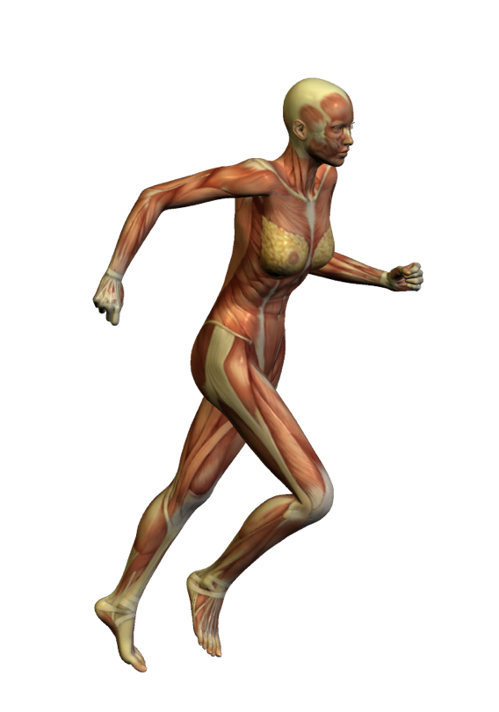
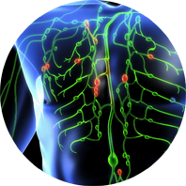
Muscular System
The lymphatic system interacts with the muscular system.
  Movement of the skeletal muscles helps to pump lymph through
  lymph vessels.
  Muscle protects some lymph nodes.
iStock

Slide 17
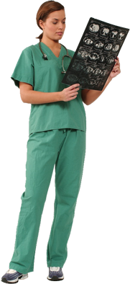
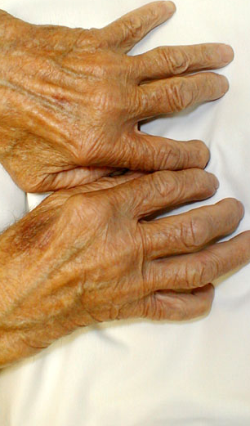
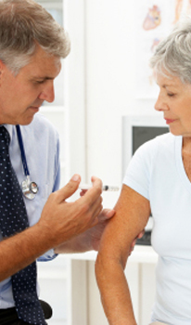

Contexts
Disease
What are the diseases of the immune system and what are their symptoms?
Medicine and Technology
How do we prevent, diagnose, and treat diseases of the immune system?
Internal Transport
The Lymphatic System
The lymphatic system and cardiovascular systems are linked in a communication network extending through the body.
Exercise and medical therapies can alleviate the symptoms of some age and disease related changes to these systems.
PHOTO: Charles Goldberg
PHOTO: CA
iStock
The Effects of Aging
How does aging affect the immune system?
Exercise
What are the effects of exercise on the immune system
and the body’s resistance to disease?
PHOTO: iStock
PHOTO: CA

Slide 18
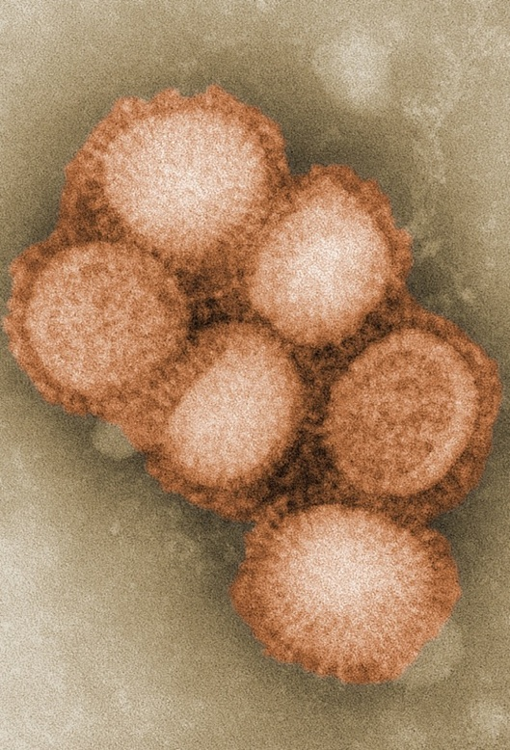
Disease
The body’s defense systems have developed to keep the body free from pathogens and disease.
Congenital or acquired diseases can cause a number of immune system disorders.
Symptoms displayed by affected people can be used to diagnose the type of disease.
Swine flu virus
CDC

Slide 19
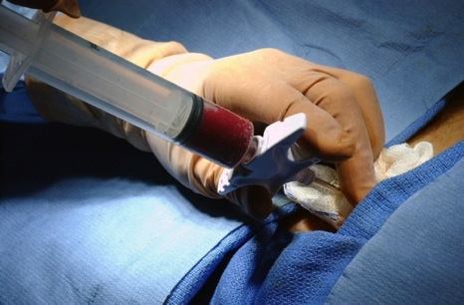
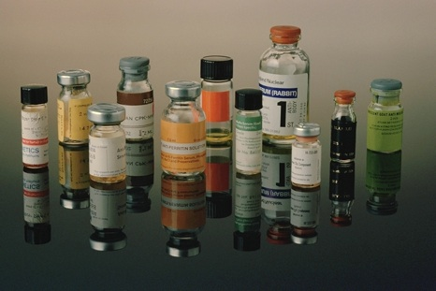
Medicine & Technology
Georgetown university hospital
In the last few decades, medical technology has made enormous gains towards the understanding of immune dysfunction.
  Faster computers for interpreting information and imaging e.g. MRI scanning.
  Greater understanding of genetic factors, e.g. susceptibility to cancers within families.
  Advances in microsurgery, e.g. lymph node transfer after treatment for breast cancer.
  Better drug development has allowed for the diagnosis and treatment of a greater range of diseases and disorders.
DS

Slide 20
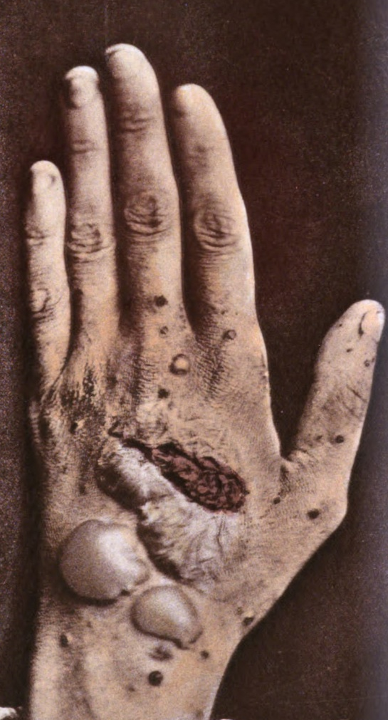
Effects of Age
Immune system function begins to fail as people grow older.
Autoimmune diseases, and disease in general, become more common in the elderly as immunocompetence declines.
Onset of autoimmune disease with age
Autoimmune disease | Age of onset
Systemic lupus erythematosus | 15-35
Giant cell arteritis | 70
Pemphigus vulgaris | 40-60
Rheumatoid arthritis | 40-60
Cancer (various) | Risk increases with age up to 85 years of age.
Multiple sclerosis | 30
Pemphigus vulgaris
George henry fox

Slide 21
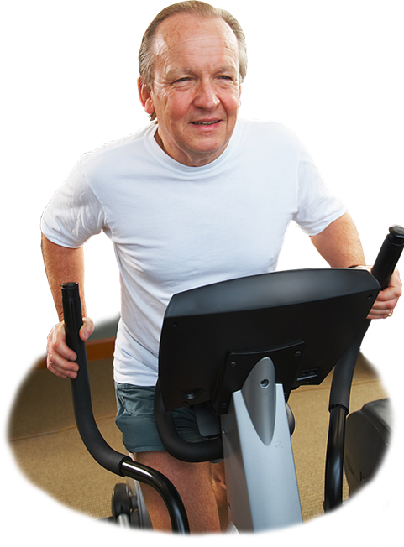
Exercise
There appears to be a close connection between the immune system and exercise.
Regular exercise, with sufficient time for recovery, can delay or reverse some of the effects of aging on the immune system.
CA
Stress
Exercise
A theoretical model (L.T. MacKinnon) of the relationship between the immune system and other variables. Illness, exercise, and stress affect each other, but each one also exerts an independent effect on immune function. Moderate, regular exercise can reduce stress and increase resistance to illness. However, excessive exercise can increase detrimental stress and may contribute to reduced immune function.
Immune system
Illness

Slide 22
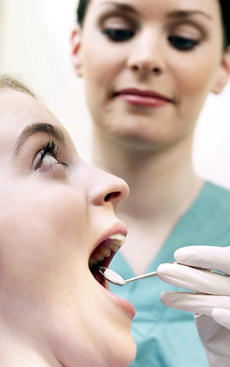
Targets for Defense
To defend itself against invading pathogens, the body must:
  First be able to recognize its own tissues
  (self recognition).
  Ignore its normal microflora.
  Deal with any abnormal cells, which may develop into cancer if not eliminated.
Self recognition has implications for
medical procedures such as tissue
grafts, tissue and organ transplants,
and blood transfusions.
Failure of self/non-self recognition can
lead to autoimmune disorders, in which the immune system mistakenly destroys its own tissues.
The human oral cavity has its own microflora
CA

Slide 23
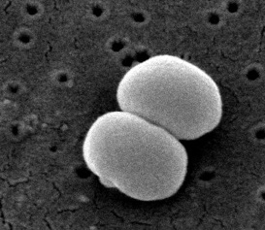
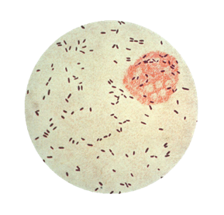
The Body’s Natural Microbiota
A typical human body contains:
  1 X 10¹³ body cells yet harbors:
  1 X 10¹⁴ bacterial cells
These microorganisms establish a relatively permanent residence.
  Under normal conditions, they do not cause disease.
The body’s normal microflora,
e.g. Staphylcoccus epidermidis and Propionibacterium acnes, normally benefit the host. They maintain the low pH of the skin, which prevents the overgrowth of harmful pathogens.
CDC Janice Carr
SEM showing S. epidermidis on the surface of the skin
CDC
P. acnes normally resides benignly in the sebaceous glands of the skin, but can over-grow in blocked pores to cause acne lesions.

Slide 24

The Body’s Natural Microbiota
Eyes: The conjunctiva, a clear mucous membrane, contains a similar microbiota to the skin.
Nose and throat: Harbor a variety of microorganisms including streptococci and staphylococci
Mouth: Supports a large and diverse microbiota. It is an ideal microbial environment being warm, and high in moisture and nutrients.
Large intestine: Contains the body’s largest resident population of microbes because of the available moisture and nutrients.
Urinary and genital systems: The lower urethra in both sexes has resident bacterial populations; the vagina has a particular acid-tolerant population of lactic acid bacteria.
Skin: Skin secretions prevents most opportunistic microbes becoming residents.

Slide 25


Distinguishing Self
Location of genes on chromosome 6 for producing the HLA antigens
Class I HLA
Class II HLA
The human immune system achieves
self-recognition through the major
histocompatibility complex (MHC).
  The MHC is a cluster of tightly linked genes on chromosome 6 in humans.
  These genes code for protein molecules (MHC antigens or MHC) which are attached to the surface of body cells.
The MHC antigens are used by the
immune system to distinguish between its own cells and foreign material.
  Class I MHC antigens are located on
  the surface of virtually all human cells.
  Class II MHC antigens are restricted to
  macrophages and B-lymphocytes.
HLA surface proteins (antigens) provide a chemical signature that allows the immune system to recognize the body’s own cells

Slide 26

Tissue Rejection
The MHC is responsible for the rejection of tissue grafts and organ transplants.
Foreign MHC molecules are antigenic, causing the immune system to respond in the following way:
  T cells directly lyse the foreign cells.
  Macrophages are activated by T cells and engulf foreign cells.
  Antibodies are released, which identify and attack the foreign cell.
  The complement system injures the blood vessels supplying the graft or transplant.
The MHC of the organ donor and recipient are matched as closely as possible to minimize rejection.
Preparing for surgery
COR

Slide 27




Human Blood Groups
Blood groups are classifications of blood according to marker molecules (antigens) on the surface of the red blood cells.
  These antigens determine the ability of red blood cells to provoke an immune response.
  Human red blood cells have more than 500 known antigens, but clinicians test for fewer than 30 antigens (in 9 blood groups) in blood is donated for transfusion.
Regularly tested antigens include:
The antigens of the ABO blood groups
O
A
B
ABO | Lutheran
Rhesus (Rh) | Kell
MNS | Duffy
P | Kidd
Lewis | (those in yellow are most commonly tested)
AB
N acetyl-galactosamine
Galactose
N acetyl-glucosamine
Fucose

Slide 28







Blood Group Antigens
Blood group | Antigens present on the red blood cells | Antibodies present in the plasma
A | antigen A | Contains anti-B antibodies, but no antibodies that would attack its own antigen A
B | antigen B | Contains anti-A antibodies, but no antibodies that would attack its own antigen B
AB | antigens A and B | Contains neither anti-A or anti-B antibodies
O | Neither antigen A nor B | Contains both anti-A and anti-B antibodies

Slide 29


Rh Incompatibility
If the father of a baby is Rh-positive and the mother is Rh-negative, their second baby, if Rh-positive, will suffer from hemolytic disease of the newborn.
Hemolytic disease of the newborn is a severe immune reaction caused by the mother’s newly acquired antibodies, which attack the unborn baby’s blood cells.
Rh-negative mother
Rh-positive baby
CA

Slide 30






Rh Incompatibility
Father’s Rh⁺ gene passed to baby
Baby’s red blood cells may enter the mother’s circulation via the placenta during delivery.
All photos CA
Father is
Rh⁺
First Pregnancy
Mother is Rh– but is pregnant with an Rh⁺ fetus. Antigens pass into the mother at birth.
Exposed to the fetal Rh⁺ antigens, the mother makes anti-Rh antibodies.
Second Pregnancy
Mother’s anti-Rh antibodies cross the placenta into the fetal blood. If the baby is Rh+, HDN results.

Slide 31
Specific and
Nonspecific Defenses
If microorganisms never encountered resistance from our defenses, we would be constantly ill and would eventually die of various diseases.
  Our immune system normally prevents this from happening.
  The immune system (which incorporates the lymphatic system) provides both non specific defenses (innate) (e.g. phagocytes) and specific defenses (adaptive) (e.g. antibodies) to remove the microorganisms that gain entry.
Nonspecific Defense Mechanisms |  | Specific Defense Mechanisms
1st line of defense | 2nd line of defense | 3rd line of defense
Intact skin Mucous membranes and their secretions | Phagocytic white blood cells Inflammation and fever Antimicrobial substances | Specialized lymphocytes (B-cells and T-cells) Antibodies

Slide 32



Innate and Adaptive
Innate resistance is resistance that is inherited. It is made of both physical barriers, and chemical and cellular defenses.
  Physical, non-specific barriers, such as the skin and mucous membranes, prevent microorganisms from entering the body.
  Non physical defenses include phagocytes and natural killer cells, which destroy pathogens that have entered the body.
Adaptive defenses provide immunity against targeted antigens (foreign bodies). Features of adaptive defenses include:
  It targets specific antigens
  It ranges throughout the body
  It “remembers” foreign particles from earlier infections
CA
Image: Obil CC 2.0
Macrophage
Antibody

Slide 33


The First Line of Defense
Undamaged skin on the surface of the hand. Note the thick keratin layer, which protects the vulnerable cells beneath.
Physical and chemical barriers form a first line of non-specific defense.
  The skin provides a physical barrier to the entry of pathogens and is rarely penetrated by microorganisms.
  The skin produces chemical
  secretions that inhibit the growth
  of bacteria and fungi.
  Low pH deters colonization by pathogenic microbes.
  Tears, mucus, and saliva help
  to wash microbes away.
EII

Slide 34


The First Line of Defense
EII
If microorganisms enter the body, they face a range of other defenses.
The natural microflora of intact skin inhibits the growth of most pathogenic microbes.
Microorganisms are trapped in sticky mucus and expelled by cilia.
Intact skin
Lining of the respiratory, urinary, reproductive, and gastrointestinal tracts
The 2nd line of defense

Slide 35




The Second Line of Defense
A range of non-specific defenses inside the body inhibit or destroy pathogens.
Non-specific defenses react to the presence of any foreign body, regardless of its nature.
White blood cells are involved in most of these responses.
The 1st line of defense
The 2nd line of defense
Eosinophils:
Produce toxic proteins against certain parasites, some phagocytosis
Antimicrobial substances
Inflammation and fever
40°C
Basophils:
Release heparin and histamine which promote inflammation
37°C
Phagocytic white blood cells
Neutrophils, monocytes:
These cells engulf and destroy foreign material
(e.g. bacteria)
The 3rd line of defense

Slide 36




The Third Line of Defense
Specific resistance provides the third line of defense. It forms the immune response, recognizing and targeting specific pathogens.
Specialized cells of the immune system, called lymphocytes, are:
  B-cells: Produce proteins called antibodies. Each type of antibody is produced against and specific to a different antigen.
  T-cells: Target pathogens directly.
The 2nd line of defense
The 3rd line of defense
B cell:
Antibody production
Lymphocytes
T cell:
Cell-mediated immunity
Lymphocyte (SEM)

Slide 37


Blood Clotting
RBC
Blood clotting has a role in hemostasis and defense against infection.
A tear or puncture of a blood vessel initiates clotting in order to prevent blood loss and invasion of bacteria.
  Clot formation is triggered by the release of clotting factors from damaged cells.
  A hardened clot forms a scab which acts as a barrier against the entry
  of pathogens.
CDC Janice Carr
Fibrin
CDC

Slide 38

Response to Injury
Injury to the lining of a blood vessel exposes collagen fibers to the blood. Platelets stick to the collagen fibers.
When tissue is wounded, the blood quickly coagulates to prevent further blood loss and maintain the integrity of the circulatory system.
Blood clotting involves a cascade of reactions involving at least twelve clotting factors in the blood.
1
Endothelial cell of blood vessel
Red blood cell
Exposed collagen fibers
Platelet releases chemicals that make the surrounding platelets sticky.
2
Platelets
Plasma clotting factors
Damaged cells
Calcium

Slide 39


Formation of the Blood Clot
3
Platelets clump together. The platelet plug forms an emergency protection against blood loss.
Platelets
Plasma clotting factors
Damaged cells
Calcium
Clotting factors catalyze the conversion of prothrombin (a plasma protein) to thrombin (an active enzyme). Clotting factors include thromboplastin and factor VIII (antihemophilia factor).
4
A fibrin clot reinforces the seal. The clot traps blood cells and the clot eventually dries to form a scab.
Fibrin clot traps red blood cells
Prothrombin
Thrombin
Fibrinogen
Hydrolysis
Fibrin

Slide 40

The Action of Phagocytes
Phagocytes are white blood cells that ingest microbes by phagocytosis and dispose of them.
1
Detection
Phagocyte locates harmful microbes via their chemical signature (chemotaxis). The microbes stick to receptors on the phagocyte’s surface.
Bacteria
Nucleus
2
Ingestion
The phagocyte wraps pseudopodia around the bacteria, engulfing them.
Phagosome
Lysosome
3
Phagosome forms
A phagosome (phagocytic vesicle) is formed, enclosing the bacteria within a membrane.
4
Fusion with lysosome
Phagosome fuses with a lysosome (containing powerful enzymes that can destroy the bacteria).
6
Discharge
Indigestible material is discharged from the phagocyte.
5
Digestion
The bacteria are broken down by enzymes into their chemical constituents.

Slide 41


Phagocytosis Up Close
The primary stages of phagocytosis are shown in the two transmission electron micrographs (TEMs) below:
Extensions of the cell, called pseudopodia, are used to engulf microbes.
A phagosome has formed, encapsulating the bacterium.
Pseudopodia have fused.
Bacterial cell
Photos: CDC
Photos: CDC
Phagocyte
Phagocyte

Slide 42

Phagocytes are Mobile
A highly mobile nature is crucial to phagocyte function.
Some phagocytes also play a role in presenting antigenic material to other cells of the immune system. This material is derived from the digested parts of the microbe.
This false color electron micrograph illustrates the highly mobile nature of phagocytes.
Volker Brinkmann, PloS, released under CCL2.5
Neutrophil (yellow) engulfing anthrax bacteria (orange)

Slide 43




Microbial Abuse of Phagocytes
Microbes evade immune detection
Some microbes kill phagocytes
Dormant microbes hide inside cells
Some microbes may evade detection by the immune system by entering phagocytes and preventing fusion of the lysosome with the phagosome. They then multiply inside the phagocyte.
e.g. Chlamydia, Shigella, Mycobacterium tuberculosis, and malarial parasites (Plasmodium spp.)
Some microbes produce toxins that kill phagocytes.
e.g. toxin-producing staphylococci and the dental plaque-forming bacteria Actinobacillus.
Some microbes can remain dormant inside the phagocyte for months or years at a time.
e.g. the microbes that cause brucellosis and tularemia.

Slide 44


Inflammation
Inflammation is a beneficial, defensive response triggered by damage to the body’s tissues by physical agents (e.g. sharp objects), microbial infection, or chemical agents.
Inflammation is usually characterized by four symptoms: pain, redness, heat, and swelling.
Inflammation has the following functions:
  To destroy the cause of the infection and
  remove it and its products from the body
  If this fails, to limit the effects on the body
  by confining the infection to a small area
  To replace or repair tissue damaged by
  the infection by improving blood flow
Inflamed infected ingrown toenail
Wiki
Inflamed mouth ulcer
CDC

Slide 45

The Process of Inflammation
1
Bacteria entering on knife or other sharp object.
2
Blood clot forms
3
Chemicals released by damaged cells (e.g. histamines and prostaglandins) attract phagocytes to the infection.
Epidermis
Dermis
4
Blood vessels increase in diameter and permeability in the area of damage. This increases blood flow to the area and allows defensive substances to leak into tissue spaces.
Subcutaneous tissue
6
An abscess starts to form after a few days. This collection of dead phagocytes, damaged tissue and various body fluids is called pus.
5
Phagocytes reach the damaged area within one hour of injury. They squeeze between cells of blood vessel walls to enter the region and destroy invading microbes.

Slide 46

The Process of Inflammation
Red blood cells
Phagocytes stick to capillary walls
Capillary wall
Increased diameter and permeability of blood vessels
The increased diameter and permeability of the blood vessels in the area of inflammation increases blood flow to the area and allows defense substances to leak into tissue space.
Phagocyte migration and phagocytosis
Phagocytes arrive within one hour of the injury. They squeeze between the cells of the blood vessel walls to reach the damaged area where they destroy invading microbes.
Tissue repair
Functioning cells or supporting connective tissue cells create new tissue to replace dead or damaged cells.
Phagocytes squeeze between the endothelial cells of the blood vessel.
Bacteria are engulfed and destroyed by phagocytes (macrophages and neutrophils).

Slide 47




Tissue Repair
Some tissues e.g epithelial tissues, such as skin, regenerate easily, but others do not at all (cardiac muscle).
In tissues that do not regenerate, the damaged tissue is often replaced by scar tissue, which has none of the original tissue’s function.
Wound 30 minutes after injury
Wound 3 days
after injury
Wound 17 ½ days after injury
Wound 30 days
after injury
All photos: Jpbarrass
Capillaries become permeable, allowing clotting proteins into the injured areas to form a clot and stop the bleeding
Where the clot is exposed to the air a scab forms, protecting the regenerating tissue beneath.
Granulation tissue forms, containing many new capillaries, phagocytes that dispose of the blood clot, and fibroblasts that help the formation of scar tissue.
Surface epithelium regenerates from the edges of the wound beneath the scab, which eventually detaches.

Slide 48


Fever
A fever (pyrexia) is defined as a body temperature above 37°C (98.6°F) measured in the mouth.
  Normal body temperature range is:
    36 to 37°C
    96.8 to 98.6°F
  Fevers are usually caused by bacterial or viral infections.
  Fevers of less than 40°C (104°F) do not need treatment.
  Excessive fever requires prompt attention as death usually results if body temperature rises above 44.4°C to 45.5°C (112°F to 114°F).
iStock
Hemera

Slide 49

The Benefits of Fever
Up to a point, fever is beneficial.
Fever has the following effects:
  Intensifies the effect of interferons (antiviral proteins that inhibit viral replication)
  Increases the production of T cells
  Speeds up the metabolic reactions,
  which helps to increase the rate of
  tissue repair
  Increases heart rate, so that white blood cells are delivered to sites of infection more rapidly
Flushed skin is a characteristic of fever
CA

Slide 50




The Cause of Fever
Bacterium
Macrophage
Bacterial toxins
Infection by pathogen or toxin
Infection from viruses and bacteria (or their toxins) is the most frequent cause of fever. A macrophage ingesting a pathogen begins the processes leading
to fever.
Macrophages respond
A macrophage ingests a bacterium, destroying it and releasing endotoxins. The presence of endotoxins induces the macrophage to produce a small protein called interleukin-1.
Thermostat is reset
Interleukin-1 induces the hypothalamus to increase production of prostaglandins. This resets the body's 'thermostat' to a higher temperature, producing fever.
Macrophage releases interleukin-1 into the blood stream.
Hypothalamus
Temperature increases beyond the normal range of 36.2–37.2 °C (96.8–98.6 °F)

Slide 51
The Stages of a Fever
Fever Onset
The body responds to the new thermostat setting, raising the body temperature by:
• Blood vessel constriction
• Increased metabolic rate
• Shivering
iStock
Chill Phase
Even though the body temperature is increasing above normal, the skin remains cold, and shivering occurs.
This condition, called a chill, is a definite sign that body temperature is rising.
When the body reaches the setting of the thermostat, the chill disappears.
Crisis Phase
Hemera
Body temperature will be maintained at the higher setting until interleukin-1 has been eliminated.
As the infection subsides, the thermostat is then reset to the normal.
Heat losing mechanisms, such as sweating and vasodilation, cause the person to feel warm.
This crisis phase of the fever indicates that body temperature is falling.

Slide 52

Symptoms of Disease
Symptoms of disease or infection include:
  Pain (moderate to severe)
    The pain experienced due to illness depends on the disease and the part of the body affected. Pain symptoms may vary from intense and acute pain to general soreness throughout the body.
  Loss of function
    Autoimmune diseases and diseases of the immune system causes the immune system to lose its ability to function.
  Swelling
    Swelling is part of the inflammatory _x000b_response that allows immune cells to reach damaged tissue.
  Tissue loss and gangrene
    Necrosis caused by an infection and a loss of circulation can be life threatening.
Image: Sapp

Slide 53


Diagnosis of Disorders
There are many diagnostic techniques available to medical practitioners today:
  X-rays, MRI, scintigraphy, and CT scans
  These techniques allow high precision imaging of the interior of the body.
  MRI is commonly used to diagnose lymphedema.
  Lymphoscintigraphy checks the lymph system for disease. A radioactive substance is injected into the body and flows through the lymph ducts. A scanner follows the movement of this substance on a computer screen.
  Ultrasound
  Ultrasound can be used as an alternative to CT scans and X-rays to identify diseases such as breast cancer.
  DNA tests and blood tests are routinely carried out to test for a range of diseases and disorders.
iStock
Ultrasound examination of breast
Image: NIH
NIH
DNA microarray showing gene expression patterns in Burkitt’s lymphoma. Green shows genes over-expressed, red shows genes under-expressed.

Slide 54

The Lymphatic System
Tonsils and adenoids
Thymus gland
The lymphatic system is a network of vessels that drains lymph fluid from the tissues back into the circulatory system.
This network is part of the immune system and is one of the body’s major defenses against infection and cancer.
Spleen
Thoracic duct
Lymphatic vessels
Bone marrow
Lymph nodes

Slide 55

Lymphatics: Upper Body
Thymus gland
The thymus is a two-lobed organ close to the heart. It is large in infants and children
and regresses with age.
T cells, which destroy invading microbes, mature in the thymus.
Tonsils
The tonsils and adenoids (also called pharyngeal tonsils) are a collection of large lymphatic nodules at the back of the throat.
They produce lymphocytes and are well-placed to protect against invasion of pathogens entering the body via the pharynx and airways.
The Upper Body
Spleen
The spleen metabolizes old red blood cells and holds a reserve of blood (e.g. in cases of severe bleeding).
The spleen is also active in the cellular (T cell) and humoral (B cell) immune responses.
Thoracic duct
The thoracic duct is the main collecting duct of the lymphatic system.
Lymph reenters the general circulation via the subclavian veins near the heart.

Slide 56


Lymphatics: Lower Body
Lymphatic vessels
When tissue fluid enters the lymph capillaries, it is called lymph.
The lymph passes along lymphatic vessels to a series of lymph nodes.
Lymphatic vessels contain one-way valves that move the lymph towards the heart and reintroduce it to general circulation via the subclavian veins.
Bone marrow
Bone marrow produces the stem cell precursors to all blood cells. As well as red blood cells and platelets, these differentiate into:
• monocytes (and macrophages)
• neutrophils
• eosinophils
• basophils
• lymphocytes (B cells and T cells)

Slide 57

Tissue Fluid and Lymph
Fluid leaks from capillaries to form the tissue fluid (interstitial fluid).
Tissue fluid surrounds and bathes the cells, supplying them with nutrients and oxygen and removing wastes.
  Tissue fluid is similar in composition to plasma but lacks large proteins.
  Some of the tissue fluid returns directly into the capillaries, but some drains back into the general circulation through a network of lymph vessels.
  This fluid, called lymph, is similar in composition to tissue fluid, but contains more leukocytes (white blood cells).
Blood flow
Lymph vessel
Arteriole
Venule

Slide 58


Lymph and the
Immune System
Apart from its circulatory role, the lymphatic system has an important function in the immune response.
  Mixed up with the lymph are pathogens and other foreign substances that must be destroyed.
  Lymph nodes are the primary sites where this occurs.
  A lymph node that is actively fighting an infection becomes swollen and hard as the the number of leukocytes (particularly lymphocytes) increase rapidly in response to the infection.
iStock
Lymph node

Slide 59

Lymph Nodes
Trabeculae
Incoming lymph vessel
Lymph nodes are oval or bean shaped structures scattered throughout the body.
They are found in groups along the length of the lymphatic vessels.
  Lymph nodes filter lymph by trapping foreign particles in a meshwork of elastic and reticular fibers inside the node.
  Once trapped, the foreign substances are phagocytosed by macrophages and destroyed.
  Lymph nodes are also at store of lymphocytes (T cells and B cells), which circulate to other parts of the body vis the outgoing lymph vessel.
Lymph nodule (contains T and B lymphocytes)
Valve
Blood vessel
Outgoing lymph vessel
Capsule
Medulla
Lymph node

Slide 60


Immunity
We have natural or innate resistance to certain illnesses, including most diseases of other animal species.
Immunity involves a specific defense
response to invasion by foreign organisms or substances.
Acquired immunity is the protection
developed against specific microbes or
foreign substances.
  Active immunity develops after exposure
  to microorganisms or foreign substances.
  Passive immunity is acquired when antibodies are introduced to the body from another source.
  Active and passive immunity may be artificially acquired as a result of medical treatment, or it may be naturally acquired.
US Navy
Vaccines provide artificially acquired active immunity
A fetus acquires pre-formed maternal antibodies across the placenta and from the mother’s breast milk during lactation.
COR

Slide 61


Naturally Acquired Immunity
Naturally Acquired
Passive
Antibodies pass from the mother to the fetus via the placenta during pregnancy or to her infant through her milk.
The infant's body does not produce any antibodies of its own.
Active
Antigens can enter the body naturally, as occurs when:
Infection by microbes causes full expression of the disease.
There is a sub-clinical infection (one with no obvious symptoms).
The body produces specialized lymphocytes and antibodies against the target pathogen.
bacterium
Virus
EII

Slide 62




Artificially Acquired Immunity
Artificially Acquired
Active
Antigens (weakened or dead microbes or their fragments) are introduced in vaccines.
The body then makes specific lymphocytes and antibodies.
Passive
Preformed antibodies in an immune serum are introduced into the body by injection (e.g. anti-venom used to treat snake bites).
The body does not produce any antibodies but receives them passively.
iStock

Slide 63

The Immune System
There are two main components of the human immune system:
  Humoral immune system
  Associated with B-cells, which produce antibodies. The humoral system is associated with serum, the non-cellular part of the blood.
  Cell-mediated immune system
  Associated with the production of specialized lymphocytes called T-cells.
The humoral and cell-mediated systems work separately and together to protect us from disease.
Red blood cells (erythrocytes)
Lymphocyte
EII

Slide 64



B–Cells
SEM
B-cells (also called B-lymphocytes) originate and mature in the bone marrow of the long bones (e.g. the femur).
They migrate from the bone marrow to the lymphatic organs, e.g. the spleen.
B-cells defend against:
  Bacteria and viruses outside the cell
  Toxins produced by bacteria (free antigens)
Each B-cell can produce antibodies against only one specific antigen.
A mature B-cell may carry as many as
100 000 antibody molecules embedded in its surface membrane.
VU
TEM
Nucleus
VU
Mitochondria
Simplified representation
B-cells (B-lymphocytes) shown in a SEM, false color TEM (note mitochondria), and simplified representation.

Slide 65




B–Cell Differentiation
B-cells differentiate into two kinds of cells:
Bound antigen
B lymphocyte
Antibody
Memory cell
Plasma cell
Plasma cells
Plasma cells secrete antibodies against specific antigens.
  Each plasma cell has a lifespan of only a few days, but can produce about 2000 antibody molecules per second.
Memory cells
Memory cells are long lived and reside in the lymph nodes and provide future immunity.
  When these cells encounter the same antigen again (even many years after the initial infection), they rapidly differentiate into antibody-producing plasma cells.

Slide 66



Humoral Immunity
Surface antigen
Other B-cells recognize different antigens
1
The humoral response begins when a foreign protein (antigen) binds to a specific B-cell.
Recognition
B-cell
2
Antigen binding stimulates the B-cell to proliferate, forming many plasma cells.
Plasma cells make antibodies to attack and destroy a specific identified pathogen.
Pathogen
Plasma cells
Second Exposure
Antibody
Original
B-cell
3
Some B-cells differentiate into long lived memory cells.
These memory cells will rapidly produce antibodies if the same pathogen enters the body again.

Slide 67

T-Cells
T-cells originate from stem cells and mature after passing through the thymus (located above the heart over the trachea).
T-cells provide cellular immunity against:
  Intracellular bacteria and viruses
  Protozoa, fungi, flatworms, roundworms
  Tumor cells and transplanted foreign tissue
Molecular Immunology Foundation, www.mifoundation.org
T-cells attacking a cancer cell

Slide 68



T-Cell Activation
T-cells are activated by antigenic fragments that are processed and presented bound to MHC molecules by infected cells or macrophages.
  Cells with a special role in processing and presenting antigens are called antigen-presenting cells and include macrophages.
Cell mediated immunity (attack infected cells)
Antigen processing
Self-protein
T-cell antigen receptor
Cytotoxic (killer) T-cell
Antigen
Activation of:
Helper T-cell
Cytokines
Presented antigen
Cytokines
Humoral mediated immunity (secretion of antibodies)
Macrophage
B-cell

Slide 69







T-Cell Differentiation
Helper T-cells activate cytotoxic T cells and other helper T cells. They are necessary for B-cell activation and secrete cytokines. These small proteins assist in the immune response.
Naive T-cell
Gamma delta T-cells are distinguished from other T-cells by having ϒ and δ receptors on their surface (instead of α and β). They can recognize whole proteins without first having them presented.
TH
ϒδ
TM
TReg
Memory T-cells are a long, lived TH cell and provide the immune system with a memory by recognizing and responding to past pathogens.
Regulatory T-cells shut down T-cell mediated immunity at the end of the immune response.
TC
NKT
Cytotoxic T-cells recognize and destroy infected cells. They may also be part of the process of tissue rejection.
Natural killer T-cells bridge the innate and adaptive immune systems. They perform functions of both TC and TH cells.

Slide 70


Cell Mediated Immunity
1
Cytotoxic T-cells
Antigen produced by abnormal cell
Antigens, such as those produced by abnormal cells, are identified by and activate specific cytotoxic T-cells.
TC
TC
Recognition
TC
Helper T-cell
TH
TC
Note: HIV (the AIDS virus) disrupts the cellular immune system by destroying helper T-cells.
2
With the assistance of helper T-cells the cytotoxic T-cells begin to multiply.
TC
TC
TC
3
The cytotoxic T-cells attach to and destroy the abnormal cell. Cytotoxic T-cells remain as memory cells to quickly attack any abnormal cells that reappear.
TC

Slide 71

Exercise and Immunity
Exercise can have positive effects on the immune function:
  Improved immune function
    Exercise triggers a rise in neutrophils and the activity of macrophages. Prolonged, strenuous activity can cause levels to remain elevated for 24 hours or more.
Severe or over-exercising can have detrimental effects on the immune system.
Upper Tract Respiratory Disease (URTI) vs Level of Exercise
Above average
Average
Risk of URTI
Below average
Excessive exercise, especially beyond current fitness level, can cause a reduction in immune functioning.
Sedentary
Moderate
Very high
Level of exercise
CA

Slide 72


Antigens and Antibodies 1
iStock
Antibodies and antigens play key roles in the response of the immune system.
Antigens are foreign substances that cause the formation of antibodies.
Antigens include:
  Potentially damaging microbes and
  their toxins
  Substances such as pollen and flea
  and dust mite feces
  Blood cell surface proteins
  The surface proteins of transplanted tissues and organs
The feces of dust mites and fleas are antigenic in some people
EII
SEM of pollen grain.
Many pollens are antigens.

Slide 73


Antigens and Antibodies 2
Molecular model
Symbolic model
Antibodies (also called immunoglobulins) are proteins made in response to antigens.
  Antibodies recognize and bind
  to antigens.
  Antibodies are highly specific and can help destroy antigens.
  Each antibody has at least two sites that can bind to an antigen.
Antibody
One of the two binding sites on the antibody
Antigen

Slide 74

Antibody Structure
Heavy chain (long)
Hinge region connects light and heavy chains, allowing them to open and close (like a clothespin).
Most of an antibody molecule is made up of constant regions which are the same for all antibodies of the same class.
Light chain (short)
Variable regions form the antigen-binding sites. Each antibody can bind two antigen molecules.
Antibody
The site on the antigen that is recognized by the immune system is called the epitope or antigenic determinant.
Antigen: Most antigens are proteins or large polysaccharides and are often parts of invading microbes.
Examples: cell walls, flagella, bacterial toxins, viral proteins, and other microbial surfaces.

Slide 75





Inactivation of Antigens
Neutralization
Clumping
Precipitation
Antibodies
Antibody
Bacterial cell
Virus
Soluble antigens
Toxin
Bacterial toxins and viruses are bound by antibodies and neutralized.
Particulate antigens, e.g. bacterial cells, are stuck together in clumps.
Soluble antigens are stuck together to form precipitates.
Macrophage
Bacterial cell
Phagocytosis is enhanced

Slide 76




Activation of Complement
Complement proteins tag foreign cells for destruction by phagocytes
The complement system is made up of small proteins, which normally circulate in the blood as inactive precursors.
It is activated by antigen-antibody complexes and helps the immune system to clear pathogens from the body.
Bacterial cell
Blood vessel
Macrophage
Bacterial cell
Macrophage
Bacteria
Lesion
Bacteria
Enhances phagocytosis
Enhances inflammation
Leads to rupture of foreign cell

Slide 77


Immune System Disorders
Disorders of the immune system include:
  Cancers (e.g. lymphoma)
  Infections and infectious diseases (e.g. HIV)
    HIV specifically targets the T-cells, reducing the body’s ability to fight off secondary infections or detect and destroy tumor cells.
    Lymphatic tissues can become infected by viruses or bacteria (e.g. Streptococcus)
  Inherited disorders (e.g SCID)
    Inherited disorders that affect the immune system could potentially be treated using gene therapy.
  Autoimmune disorders
    The loss of the ability to distinguish self from
    non-self can cause the immune system to attack cells of the body.
CDC
Kaposi’s sarcoma
UCSD School of Medicine: Charles Goldberg
Rheumatoid arthritis

Slide 78


Treating Immune Disorders 1
Treatments for immune disorders range from surgery to drug therapy.
  Surgery
        Tissue may be removed to prevent spread of infection or arrest a disease (e.g. chronic cases of tonsillitis are treated by tonsillectomy and an autoimmune disease causing destruction of platelets in the spleen is treated by splenectomy).
  Radiotherapy
        Radiotherapy is commonly used to treat cancers. Lymphoma, a cancer of the lymphatic system, causes the lymph nodes to form a tumor.
CA
Lymphomas are treated with external beam radiation. High energy X-rays are focused on to the affected area to destroy cancerous cells.
iStock
Chronic infection of the tonsils may mean they are removed. In children the adenoids (pharyngeal tonsils) are often removed at the same time.

Slide 79


Treating Immune Disorders 2
  Drug and physical therapies
    Immunosuppressive drugs may to used to treat autoimmune diseases and are routinely used after organ transplant surgery.
  Immunotherapy (desensitization)
    Controlled administration of increasing doses of an antigen can help to increase the immune system’s tolerance to that antigen and prevent inappropriate immune responses.
  Gene and cell therapy
    Replacing damaged tissues with immunologically identical transplants should reduce or remove any need for immunosuppressant drug treatments after transplant surgery.
CA
Image: NIH
Human embryonic stem cells

Slide 80


HIV and AIDS
SEM
HIV budding from cell
AIDS (Acquired Immune Deficiency Syndrome) was apparently an emerging disease when it first appeared in the human population.
  AIDS was first detected in Los Angeles, USA in 1981.
  By 1983 the pathogen causing the disease (shown right) had been identified as a retrovirus, which selectively infects helper T cells and results in low T cell numbers.
  The virus, which eventually causes a collapse of the immune system, was given the name Human Immunodeficiency Virus (HIV).
  In 1986, a second type of HIV, called HIV-2, was isolated from AIDS patients in West Africa, where it may have been present decades earlier.
  As yet, there is no cure for AIDS. The disease is now a global pandemic.
CDC
iStock
The Human Immunodeficiency Virus (HIV)

Slide 81

Structure of the HIV Virus
Capsid
Protein coat that protects the nucleic acid (RNA) within
Viral envelope
A piece of the plasma membrane taken from the host when a new viral particle buds from the cell.
Surface proteins
These spikes allow HIV to attach to receptors on the T cells and macrophages.
Nucleic acid
Two identical strands of RNA contain the genetic blueprint for making more HIV viruses.
Reverse transcriptase
Two copies of this enzyme transcribe the RNA into DNA once inside a host cell.

Slide 82







How HIV Infects a T Cell
1
HIV particle is attracted to CD4 receptors on a helper T cell.
Infecting HIV
2
HIV particle fuses with the plasma membrane of the T cell and the capsid is removed by enzymes.
CD4 receptors
5
The double stranded DNA is incorporated into the host cell's chromosome.
RNA
3
Reverse transcriptase causes the formation of viral DNA (using the RNA as a template).
Nucleus
4
A complementary strand of DNA is formed.
6
Viral genes are transcribed into mRNA molecules.
DNA
7
Viral mRNA is translated into HIV proteins.
9
Budding of the new viruses from the host cell.
8
Assembly of capsids around the viral genomes.
New viral particles

Slide 83


HIV Infection
HIV infection results in a huge range of symptoms, which are not the result of the HIV infection directly.
  Individuals affected by the virus may have no symptoms, while medical examination
  may detect only swollen lymph glands.
  Some individuals may experience a short-lived illness when they first become infected.
  The symptoms of HIV/AIDS arise from the many secondary infections occurring as a result of the depleted helper T cell population and suppressed immune system.
  These infections are usually caused by rare fungi, viruses, and bacteria.
  Full blown AIDS can also feature some rare
  forms of cancer (e.g. Kaposi’s sarcoma).
Pneumocystis pneumonia is caused by a rare yeast-like fungus. It is rare in healthy immunocompetent people but common in AIDS patients. The increased opacity in the lower lungs on both sides is diagnostic.
NIH
Pneumocystis jirovecii cysts (washing from an infected lung)
CDC

Slide 84

Symptoms of AIDS
Fever, lymphoma of the brain (a cancer), toxoplasmosis of the brain, dementia.
Eye infections (Cytomegalovirus).
Skin inflammation (dermatitis) particularly affecting the face.
Oral thrush (Candida albicans) of the esophagus, bronchi and lungs.
Marked weight loss.
A variety of opportunistic infections, including: chronic or persistent herpes simplex, tuberculosis (TB), pneumocystis pneumonia (PCP), shingles, shigellosis, and salmonellosis.
Diarrhea caused by Cryptosporidium or Isospora.
A number of autoimmune diseases, especially thrombocytopenia (reduced platelet count).
Kaposi's sarcoma - a highly aggressive malignant skin tumor consisting of blue-red nodules, usually start at the feet and ankles, spreading to the rest of the body, including respiratory and gastrointestinal tracts.

Slide 85



Diagnosis of HIV
HIV is diagnosed with a blood test.
  Rapid HIV-1 antibody tests detect antibodies to HIV-1
  A fingerstick sample of blood is obtained and a precise amount is transferred to a vial where it is mixed with a reagent.
  The mix travels up a capillary device and, after 20 minutes, the test result is indicated by a color change in the window.
Photos: CDC

Slide 86

Stages of HIV Infection
AIDS is only the end stage of an HIV infection.
  Shortly after the initial infection, HIV antibodies appear within the blood.
  The progress of infection has three clinical categories, shown on the graph.
Category A:
HIV positive with little or no symptoms
Category B:
Some symptoms, low helper T cell count
Category C:
Clinical AIDS symptoms appear
Helper T cell population
iStock
HIV population
Helper T cell concentration in blood (cells per μL)
Viral RNA (copies per mL)
Years

Slide 87

Modes of HIV Transmission
HIV is transmitted in:
  Blood
  Vaginal secretions
  Semen
  Breast milk
  Across the placenta
Heterosexual activity now accounts for over 80% of new infections.
AT
In many African communities, men travel from rural settlements into the cities in search of work. These men often develop sexual networks while they are away, contract HIV, and infect their partners when they return.

Slide 88


Treating HIV Infection
HIV's ability to destroy and evade the cells of the human immune system make it difficult to treat.
HIV is treated using Highly Active Antiretroviral Therapy (HAART), which uses a combination of antiretroviral drugs.
  HAART usually consists of two different nucleoside analogue reverse transcriptase inhibitors (NARTIs)
  and either a protease inhibitor or a non-nucleoside analogue reverse transcriptase inhibitor (NNARTIs).
  NARTIs include zidovudine (also known as azidothymidine or AZT) and didanosine, which work by blocking the reverse transcriptase enzyme used by retroviruses to splice their DNA into the chromosome of the T cell.
  Protease inhibitors block the HIV protease enzyme.
  They have fewer side effects than other anti-HIV drugs.
  NNARTIs also target the reverse transcriptase enzyme but unlike NARTIs, they do not bind to the enzyme’s active site.
Photo: NIH
AZT is used with a combination of drugs
Saquinavir: a protease inhibitor

Slide 89

HIV Vaccines
There is currently no effective vaccine against HIV. This is partially because of the virus’s ability to mutate and produce new variants the immune system can’t recognize, and partially because HIV resides inside the T-cells where immune agents such as antibodies (humeral immune response) can not act.
Areas of research for HIV vaccines include:
  Recombinant Sub-Unit (RSU) vaccines are currently being trialed on humans in Africa and the UK. RSUs introduce a harmless subunit (portion) of an HIV protein into the body. This stimulates the immune system to produce HIV antibodies.
  DNA vaccines use the actual genes of HIV as a
  vaccine. Once introduced to the skin or muscle,
  the genetic material is taken up by the cells in the
  body, which then produce HIV proteins that stimulate
  the immune system. DNA vaccine educe the cell mediated
  immune response.
  Other possible vaccines include: live attenuated HIV vaccines (considered unsafe), inactivated HIV vaccines (considered risky), and peptide vaccines.
iStock

Slide 90

DNA Vaccines
When using a DNA vaccine, the patient is injected with the virus’s DNA (instead of viral antigens).
  The DNA enters the cells and is processed to produce the encoded protein, which is then digested and presented on the cell’s surface by MHC proteins where it interacts with the immune system to produce the cell mediated immune response.
  The cell mediated response is then able to actively destroy cells infected by HIV.
Proteins produced from DNA transcription and translation
DNA spliced into cell DNA
Helper T-cell
Activation of cytotoxic T-cell
DNA
Proteins presented to induce immune response.
Body cell
Proteins digested

Slide 91


Administering DNA Vaccines
DNA vaccines have been undergoing development for a number of years and may have a number of advantages over other vaccines, including:
  Little or no risk of infection by actual virus
  Activate cytotoxic T-cells
  Simplicity of manufacture
The current technique of injecting vaccines using a hypodermic needle does not work well for DNA vaccines.
New techniques for administering DNA vaccines include using a tattoo gun.
  The tattoo gun causes damage to the skin and underlying tissues, causing immune cells to accumulate there and take up the vaccine.
iStock
iStock

Slide 92

Monoclonal Antibodies
A monoclonal antibody is an artificially produced antibody that neutralizes only one specific antigen.
  Monoclonal antibodies are traditionally produced by stimulating the production of
  B-cells in mice injected with the antigen.
  These B-cells produce antibodies against
  the antigen.
  B-cells can be isolated and made to fuse with immortal tumor cells. They can then be cultured indefinitely in a suitable growing medium.
  Monoclonal antibodies are useful for 3 reasons:
    They are totally uniform (i.e. clones)
    They can be produced in large quantities
    They are highly specific
Monoclonal antibodies chemically linked to a fluorescent dye to detect the presence of gonorrhea
Photo: CDC

Slide 93







Making Monoclonal Antibodies
1a
A mouse is injected with a foreign protein (antigen).
1b
Pure tumor cells are harvested from culture
2
The mouse’s B-cells produce an antibody to recognize the antigen.
3
A few days later, antibody-producing B-cells are taken from the mouse’s spleen.
5
Some of the mouse cells fuse with tumor cells to make hybrid cells called hybridomas.
Hybridoma cells
4
The mouse cells and tumor cells are mixed together in suspension.
Mouse cell and tumor cell fusing
Unfused cell
6
The mixture of cells is placed in a selective medium that allows only hybrid cells to grow.
7
Hybridomas are screened for antibody production. They are then cultured to produce large numbers of monoclonal antibodies.

Slide 94

Diagnostic Uses of Monoclonal Antibodies
Monoclonal antibodies have many diagnostic uses:
  Detecting the presence of pathogen such as Chlamidia and streptococcal bacteria, distinguishing between Herpesvirus I and II, and diagnosing AIDS.
  Measuring protein, toxin, or drug levels in serum.
  Blood and tissue typing
  Detection of antibiotic residues in milk
  Detecting pregnancy
Monoclonal antibody technology is used in pregnancy test kits

Slide 95


Herceptin
Herceptin
Herceptin is the patented name for Trastuzumab, a monoclonal antibody for the targeted treatment of breast cancer.
The drug recognizes and is specific to the protein receptors on cancer cells produced by the HER2 gene (Human Epidermal growth factor Regulator 2).
Cancerous cells overexpress the HER2 gene (and are denoted HER2+). This causes them to divide more often than normal and form a tumor.
Herceptin
HER2 protein
Herceptin bound to HER2 protein

Slide 96



Herceptin
HER2 gene produces proteins that migrate to the surface of the cell.
HER2 protein on cell surface
HER2 gene in nucleus of cell
Cancerous cells over express the HER2 gene producing large numbers of HER2 protein on the surface of the cell.

Slide 97


Herceptin
T-cell destroys cancerous cell
Herceptin recognizes the HER2 protein and attaches to it.
Receptor site on T-cell recognizes Herceptin and attaches to it
Receptor site for Herceptin
Herceptin (monoclonal antibody)
T-cells recognize the antibody as foreign and attack it, destroying the cell and reducing the tumor.

Slide 98


Transplanting Organs
Transplant surgery involves the replacement of a diseased tissue or organ with a healthy, living substitute.
Organs are usually taken from someone who has just died, although some (e.g. blood, kidneys, and bone marrow) can be taken from living donors.
There are two major problems with organ transplants:
  Lack of organ donors
  Tissue rejection
Transplanted organs are attacked by the recipient’s immune system, leading to rejection.
This can be overcome using tissue typing and immunosuppressant drugs.
PC
iStock

Slide 99








Tissue Typing
Tissue typing is an important preliminary procedure before a patient can undergo an organ or tissue transplant.
  Without a match, the transplant will be recognized by the immune system as foreign and will be rejected.
Each person has a set of Human Leukocyte Antigens (HLAs). Half are of maternal origin and half of paternal origin.
Once a matching tissue type is found, a second test called a cross-match is carried out.
Antibody screening is carried out to determine how many different HLA antibodies are present in the patient.
A negative cross-match shows no antibodies are present.
Antigens
Antibodies
WBC
HLA genes
There are many different HLAs. It is most likely that people with matching HLAs will be related.
The patient’s blood serum is mixed with the donor’s white blood cells to test if the patient has any antibodies to the donor’s HLA.
The test also allows specialists to calculate how much antibody is present for each HLA.

Slide 100



Immunosuppressive Drugs
Foreign cells have HLAs that a recipient's immune system recognize as non-self. The recipient's immune response results in the tissue being destroyed.
Immunosuppressants aim to stop this immune rejection of foreign tissue.
  There are numerous types of immunosuppressant drugs, affecting different parts of the immune system and so with different applications.
Monoclonal antibodies can be produced to target and inhibit the recipient’s cytokines (especially interleukin 2).
Cytostatics inhibit cell division and are used to suppress T and B cell division.
Glucocorticoids suppress the cell mediated immune response by inhibiting the genes that code for the cytokines interleukin 1, 2 (most important), 3, 4, 5, 6, and 8.
Cytokine inhibition prevents acute rejection of newly transplanted tissue and helps in the treatment of autoimmune disorders.
Azathioprine is a post-transplant immunosuppressant, and is also used to treat autoimmune diseases such as rheumatoid arthritis
Interleukin 2

Slide 101

Organ Transplants
A wide variety of surgical techniques and drug therapies now make it possible to circumvent tissue rejection, so that a range of tissue and organ transplants are now possible.
Face: The world’s first face transplant was performed by a French medical team in 2008.
Lungs: Lungs may be transplanted together or separately.
Heart: Carried out after a patient suffers heart failure.
Liver: Livers are replaced when destroyed by cirrhosis, congenital defects, or hepatitis.
Pancreas: Transplanted to restore insulin production on type 1 diabetics.
Kidneys: Transplanted in cases of renal failure and diabetes.
Hands: The first successful hand transplant was carried out in the USA in 1999.

Slide 102
Tissue Transplants
Pericardium: Used to cover the brain after surgery.
Cornea: Restoration of vision.
Ear bones: Improve hearing in some forms of deafness.
Dental powder: Repairs defects in mandible.
Jaw: Facial reconstruction.
Blood and blood vessels: blood transfusions and damaged or blocked blood vessels.
Bones, bone marrow, and cartilage.
Skin: Skin grafts, especially important for burns victims.
Hip joints: Head of femur replaced with artificial joint.

Slide 103


Stem Cell Technology
Stem cells are undifferentiated cells characterized by:
  Self renewal: the ability to undergo many cycles of cell division while maintaining an unspecialized state.
  Potency: The ability to differentiate into specialized cells, with a particular structure and function.
Tissue grown from stem cells may reduce risks of rejection following transplants.
  Embryonic stem cells (ESC) are pluripotent. They can differentiate into cells derived from the three germ layers (endoderm, mesoderm, ectoderm).
Adult stem cells are multipotent. They can give rise to several cell types, but are generally limited to certain lineages, such as blood cells.
Image: NIH
Human embryonic stem cells growing on mouse embryonic fibroblasts
Image: NIH
Multipotent adult stem cells can be harvested from umbilical cord blood.

Slide 104


Embryonic Stem Cells
Embryonic stem cells (ESC) are taken from blastocysts. Blastocysts are embryos which are five days old and consist of a hollow ball of 50-150 cells.
  ESC have potential in regenerative medicine and tissue replacement. By manipulating the conditions in which the cells grow, scientists can control the types of cells grown.
  However, there are a number of ethical issues involved in using ESC derived from embryos.
Blastocyst
iStock
DS

Slide 105




Making Human ESC
Adult stem cell from patient
Remove nucleus
A mild electric shock induces the development of a new pre-embryo cell containing the patient’s DNA.
After 5 days development, the inner cell mass of about 30 stem cells is removed.
Remove nucleus to produce an empty ovum
Human ovum

Slide 106



ESC Cloning
Isolated stem cells are grown in controlled culture conditions with the appropriate growth factors to grow into the required tissue.
Insulin producing cells
Heart
Spinal cord
Kidney
Organ or tissue is transplanted back into the patient (the recipient) with no rejection problems.

Slide 107






Gene Therapy
Gene therapy refers to the application of gene technology to treat disease by correcting or replacing faulty genes.
Normal (non-faulty) DNA containing the correct gene is inserted into a vector, which is able to transfer the DNA into the patient’s cells in a process called transfection.
The treatment of somatic cells may be therapeutic, but the changes are not inherited.
1
Body (somatic) cells with defective gene are isolated from the patient.
Normal DNA
2
Copy of the normal human gene inserted into the viral DNA.
3
Body cells are infected with virus containing the recombinant DNA.
6
The expression of the normal allele relieves symptoms in the patient.
4
Somatic cells containing the introduced normal allele are cultured in a nutrient medium (the desired gene is cloned).
5
Cultured cells are injected into the patient.
Ex-vivo gene therapy

Slide 108







Gene Therapy
Modified DNA inserted into vector
Cell membrane
Cytoplasm
Vesicle membrane
Viral vector containing DNA is introduced to cell culture
Virus is taken into cell and packaged in vesicle
Virus makes its way to the cell nucleus where vesicle breaks down
Nucleus
Encoded protein is produced by the cell
Corrected DNA is integrated with the patient’s DNA
Process of infecting target cell with virus and integrating corrected DNA

Slide 109



Vectors
Vectors for gene therapy
Retrovirus
Gene therapy usually requires a vector (carrier) to introduce the DNA. They include viral and non-viral vectors.
Each vector has its own set of advantages and disadvantages.
  Viral vectors are able to insert their DNA with the target cell but may be attacked by the host’s immune system, limiting their survival rate.
    The integration of viral genes in the host DNA may cause disruption of the host’s genetic information.
  Non viral vectors may allow larger amounts of DNA to be inserted and have very little risk of causing disease, however they are not as efficient at transferring genes to the target cell.
Adenovirus
Liposome
Naked DNA

Slide 110

Using Gene Therapy (SCID)
Severe Combined Immune Deficiency (SCID) is an immune disease in which the patient’s immune system is effectively non-functional.
  There are two common forms:
  X-linked SCID and ADA-SCID.
Gene therapy for SCID involves inserting the missing gene into the stem cells in the patient’s bone marrow using a retroviral vector. The cells are then returned to the patient.
  The first clinical trials of gene therapy for ADA-SCID began in 1990, but were largely unsuccessful.
  The immune function improved but corrective drug therapy was still required, so the actual benefit of the gene therapy was unclear.
Georgetown university hospital
Bone marrow cells are extracted, treated and returned to the patient. The cells can then use the corrected gene to produce functioning proteins.
X-linked SCID caused by a mutation to the IL2RG gene located at position Xq13.1, the long arm of the X chromosome.

Slide 111
Using Gene Therapy (SCID)
Gene therapy trials on X-linked SCID in the late 1990s produced better results with virtually all patients in French and UK trials being cured.
  However 1 out of 10 in the UK, and 4 out of 10 in France developed leukemia as a result of the treatment and one patient died from a violent immune response.
New techniques since 2002 for gene therapy of ADA-SCID have been largely successful with 8 out of 10 children in an Italian trail in 2009 now leading normal lives.
  Bone marrow is partially killed to allow transplanted modified stem cells to proliferate.
Immune Cell Proliferation
Serum Antibody Levels
Studies before and after gene therapy of ADA-SCID. Immune cells (left) show a increased proliferation to immune stimuli, while antibody levels (right) in serum also show increases after gene therapy.
100
1600
1200
10
mg/dl
Stimulation index
800
Immune stimuli
Anti-CD3: monoclonal antibody used to activate lymphocytes.
PHA: Phytohemagglutinin from kidney beans triggers cell division in T cells.
Allo-antigen: Foreign antigen that triggers immune response.
Candida: Yeast common on human skin.
TT: Tetanus toxin.
400
1
0
Anti-CD3
PHA
Allo-
antigen
candida
TT
IgG
IgM
IgA
Antibody type
Before gene therapy
After gene therapy
Before gene therapy
Age matched control
After gene therapy

Slide 112

Using Gene Therapy (CF)
The most common cause of cystic fibrosis (CF) is a triplet deletion mutation to the gene coding for a chloride ion transporter (CFTR), which regulates the components of sweat, digestive juices and mucus.
  Disfunction of this gene leads to thick sticky mucus that accumulates in the lungs and intestines.
  CF gene therapy is targeted at the lungs, because the disease causes progressive damage that is ultimately lethal.
  Initial trials of gene therapy for CF were disappointing, with the treatment producing result that lasted only a few days.
  The results of new trials in 2009 were more encouraging, with some trial patients showing levels of protein production almost equal to that of a non-CF sufferer.
    Problems experienced in the trial included a patient experiencing flu-like symptoms.
iStock
Chromosome 7
The CFTR gene’s location is denoted 7q31.2, the long arm of chromosome 7

Slide 113

Immune System Disorders
Occasionally the reactions of the immune system are harmful:
  Instead of producing a desirable result, such
  as immunity to disease, the immune system may over-react, react to the wrong
  substances, or not react when it should.
  The immune system may fail to detect an infectious agent that has penetrated the first and second lines of defense.
  Some immune system disorders cause only
  discomfort, as in the case of hayfever.
  Immune system failure may lead to life-threatening conditions, such as anaphylaxis,
  AIDS and cancer (when the abnormal tumor
  cells escape immune system detection).
Photo: CDC
Kaposi’s sarcoma in the foot area of an immune suppressed AIDS patient

Slide 114

Autoimmune Diseases
Some immune system disorders involve a failure to appropriately distinguish self from non-self, so that the body’s own tissues are attacked.
Autoimmune diseases are the result of the damage caused by the immune system responding to self antigens.
Photo: James Heilman CC 3.0
Rheumatoid arthritis
Inflammation of joints leading to destruction of cartilage. The disease often begins in adulthood but can also occur in children. Rheumatoid arthritis affects more women than men. It can be treated with anti-inflammatory and immunosuppressant drugs.
Hemolytic anemia
A disorder in which the red blood cells rupture or are destroyed at an excessive rate. Caused by a variety of factors including excessively fragile red blood cells, genetic predisposition, and autoimmune disorders.

Slide 115





Multiple Sclerosis
MS is a progressive inflammatory disease of the central nervous system in which the myelin insulating the neurons in the brain and spinal cord is destroyed.
  The loss of the myelin and the scar tissue that replaces it results in impaired nerve impulse transmission and causes numbness, tingling, muscle weakness and paralysis.
Oligodendrocytes produce the myelin sheath around neurons in the CNS.
T-lymphocytes incorrectly recognize the insulating sheath as foreign, and attack and destroy the myelin.
Axon
Myelin sheath
Myelin is gradually destroyed with subsequent scarring and damage to the underlying nerve fibers.
Axon
Monocytes also attack

Slide 116


Hypersensitivity
Hypersensitivity refers to an immune system response to an antigen beyond what is considered normal.
  The immunological response to the antigen (or allergen) leads to tissue damage rather than immunity.
  Hypersensitivity reactions occur when a person has been sensitized to an antigen.
  Allergic reactions (e.g. hayfever, asthma, and anaphylaxis from insect venom or drug injections) occur very rapidly.
  Antibodies respond to an allergen by causing the release of histamine from mast cells.
Eyewire
An SEM photo showing a pollen grain
EII

Slide 117




The Basis of Hypersensitivity
1
B cell encounters the allergen and differentiates into numerous plasma cells.
B cell
Plasma cell
2
The plasma cell produces antibodies.
Mast cell
Vesicles with histamine
3
Antibodies bind to specific receptors on the surface of the mast cells.
4
The mast cell binds the allergen when it encounters it again. The mast cell releases histamine and other chemicals, which together cause the symptoms of an allergic reaction.

Slide 118


Hayfever
Hayfever (allergic rhinitis) is an allergic reaction to airborne substances such as: dust, molds, pollens, and animal fur or feathers.
  Allergy to wind-borne pollen is the most common. Certain plants (e.g. ragweed and privet) are highly allergenic.
  There appears to be a genetic susceptibility to hayfever, as it is common in people with a family history of eczema, hives, and/or asthma.
  Those with hayfever are best to avoid the
  allergen, although anti-histamines, decongestants, and steroid nasal sprays will
  assist in alleviating symptoms.
An SEM photo showing pollen grains
Photo: EII
Photo: James H. Miller, USDA Forest Service, Forestryimages.org
A privet plant in flower

Slide 119


Asthma
Asthma is a chronic (long term) disease of the lungs. It inflames and narrows the airways, resulting in difficulty breathing.
Asthma is a common disease, affecting 22 million people in the United States. It occurs in people of all ages, but most commonly first appears in childhood.
Asthma is often triggered by an allergy to house dust, pollen, and animal dander (shed skin cells, hair, feathers, etc).
James Heilman, MD CC 3.0
Asthma causes constriction of the small airways, resulting in shortness of breath.
Asthma can’t be cured, but it can be treated with various medicines such as salbutamol, administered through an inhaler.

Slide 120



Asthma
Normal airway
Asthma involves the production of histamines.
The reaction occurs in the small airways (bronchioles) where the histamine causes constriction, accumulation of fluid and mucus, and inability to breathe.
Asthma attacks are often triggered by environmental factors such as cold
air, exercise, air pollutants, and
viral infections.
Muscle
Airway wall
Airway during asthma attack
Tightened muscles constrict airway
Inflamed airway wall
Narrowed airway limiting air flow
Histamine
Mucus

Slide 121
Effects of Aging on the Immune System
As people age, immune system function begins to decline:
  Higher rates of autoimmune disease
    Possible age related mutations in immune cells cause them to lose their ability to distinguish self from non-self.
  Increased susceptibility to disease
    The thymus, where T-cells mature, decreases with age, reducing the production of T-cells and the ability of the immune system to respond to foreign substances.
    At 60 years, the volume of thymus tissue is only about 5% of that of a newborn.
Adults Aged 18 and Older With Arthritis
600
Female
Male
Data: CDC
500
400
Rate per 1000 population
300
200
100
0
18 - 41
45 - 64
65- 71
75 and older
Age (years)

Slide 122
Glossary
Click a word from the glossary to go to that slide!
Cancer | Condition in which mutations in genes regulating cell growth and division allow cells to grow and divide in an uncontrolled fashion resulting in a tumor.
DNA | Deoxyribonucleic acid. Double stranded nucleic acid construction of one of four bases (A, T, C, G), a phosphate group and deoxyribose sugar. Stores the genetic code in all organisms.
Endotoxin | Toxin associated with Gram-negative bacteria. Typically a lipopolysaccharide found in the outside membrane of the bacteria and recognized by the immune system.
Emerging disease | Disease that appears and has no previous history in the population it affects.
Gene | A particular part of the chromosome which confers the basic unit of inheritance.
Hemostasis | The process by which bleeding is stopped.
Histamine | A chemical generated by mast cells in response to injury or allergens. It is responsible for the inflammatory response along with other physiological effects.
Immune system | A body system that protects the body from disease. It is closely allied to the lymphatic system but it is a functional system rather than an anatomical organ system.
Lysosome | Membrane-bound vacuolar organelle which contains enzymes that form part of the intracellular digestive system.
Maternal | From the mother.
Microflora | The microscopic flora of a specific region, including bacteria and fungi.

Slide 123
Glossary
Click a word from the glossary to go to that slide!
Pandemic | Disease epidemic that has spread throughout the world.
Paternal | From the father.
Pathogen | A disease-causing organism.
Plasma | The liquid component of blood in which the blood cells are suspended. Consists mostly of water (93%) and various other dissolved chemicals including proteins, CO2, and hormones.
Protein | Complex macromolecule built from amino acids joined together by peptide bonds. All proteins contain carbon, hydrogen, oxygen and nitrogen and most contain sulfur.
RNA | Ribonucleic acid. Single stranded nucleic acid constructed of a base (A, U, C, G) a phosphate group and a ribose sugar. Three types are identified tRNA, mRNA and rRNA.
Somatic | Referring to the body, rather than sex. For example, somatic cells refer to the body cells, rather than the gametes.
Toxin | A poisonous substance produced by a living organism (as opposed to a toxicant which is a human-made artificial poison).

Slide 124


Slide 125
Conditions of Use
NOTE: Presentation Media = presentations available on CD-ROM/DVD-ROM or as downloads
BIOZONE retains copyright to the intellectual property included in the Presentation Media files, with acknowledgement that certain photos are used under license and are credited appropriately.
You MAY:
Use the Presentation Media files for presentations in your classrooms using a data projector, interactive whiteboard or overhead projector.
Place the Presentation Media files on any staff computer within the school, including staff laptops, but not in contradiction to clause (g).
Place the Presentation Media files on:
  The school’s intranet (school computer network)
  VLE (Virtual Learning Environment)
  A CMS (Content Management System).
Student and staff access must be restricted to those who are enrolled/working on the campus of the registered purchaser. Student and staff access to a VLE or a CMS must be controlled by a user login and password protocol, but not in contradiction to clause (f). If students have access, they need to be made aware of the Conditions of Use and are only allowed to view the content.
Edit and customize the Presentation Media files by adding, deleting, and modifying information to better suit your needs, but not in contradiction to clauses (h) - (l).
Print out the Presentation Media files in PowerPoint® or Keynote® “Handouts” mode for the express purpose of allowing students to make their own notes about the presentation, but not in contradiction to clause (j).
You MAY NOT:
Place the Presentation Media files on to the Internet or on a service that may be accessed off-campus unless access to the service is protected by a user login and password protocol, and is restricted to students and staff enrolled/working on the campus of the registered purchaser.
Place the Presentation Media files on student laptop computers.
REMOVE any of the references to BIOZONE, the title slides, copyright notices, photo credits, or Conditions of Use from the Presentation Media files.
  Create a NEW document using any of the graphics/images in the Presentation Media files.
  Print the Presentation Media files on to paper to make your own worksheets for distribution to students.
  I ncorporate any part of the Presentation Media files for the production of another commercial product.
  Share or give away any content off-campus. This prohibition apples to, but is not limited to, sharing via the Internet or any website, (examples: YouTube, slide sharing websites).
Conditions of Use are subject to change without notice. Visit www.thebiozone.com/conditionsofuse

Slide 126
Photo Credits
Photographic images are used under license from the following commercial photo libraries:
  Corel Corporation Professional Photos (uncoded)
  ArtToday.com (coded AT)
  Clipart.com (coded CA)
  PhotoObjects.com (coded PO)
  iStock.com (coded iStock)
  Hemera Technologies Inc. (coded Hemera)
  Photos.com (coded PC)
  Education interactive (coded EII)
  Visuals unlimited (coded UV)
  Waikato Microscope Unit (Coded WMU)
  Digital Stock (coded DS)
  LifeArt (coded LA)
3D models were created using Poser 8
Additional artwork and photographs are the property of BIOZONE International Ltd. All rights reserved.
Some 2D artwork has been adapted from TechPool STUDIOS LifeArt Collections, used under licence.
Images from the Public Domain: Where these licenses have been used, authors and licenses have been acknowledged alongside their image.
  Centers for Disease Control (coded CDC)
  National Institutes of Health (coded NIH)
  Images from the public domain include limited copyright,
  copyright expired, uncopyrighted, or uncopyrightable material:
    Licenses including: GNU Free Documentation License
    http://www.gnu.org/copyleft/fdl.html
    Creative Commons Attribution Share Alike
    http://creativecommons.org/licenses/by-sa/3.0/
    Wikimedia Commons
NOTE: Where images are edited or moved from or within this file, the accompanying photo credit must be retained.

Slide 127


